Slide 2
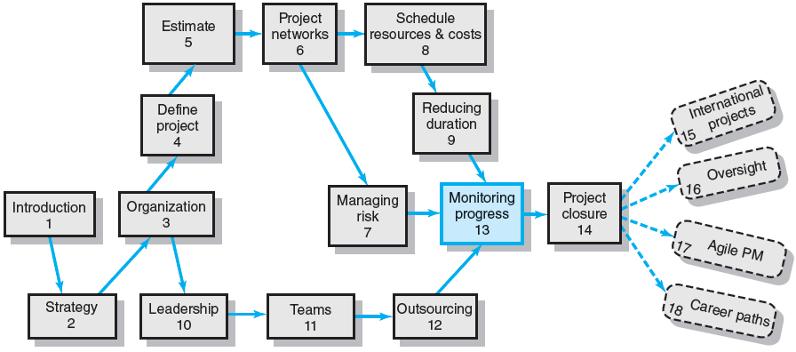
Where We Are Now

Slide 3
Structure of a Project Monitoring Information System
Creating a project monitoring system involves determining:
What data to collect
How, when, and who will collect the data
How to analyze the data
How to report current progress to management

Slide 4
Project Monitoring Information System
Information System Structure
What data are collected?
Current status of project (schedule and cost)
Remaining cost to complete project
Date that project will be complete
Potential problems to be addressed now
Out-of-control activities requiring intervention
Cost and/or schedule overruns and the reasons for them
Forecast of overruns at time of project completion

Slide 5
Project Monitoring System… (cont’d)
Information System Structure (cont’d)
Collecting data and analysis
Who will collect project data?
How will data be collected?
When will the data be collected?
Who will compile and analyze the data?
Reports and reporting
Who will receive the reports?
How will the reports be transmitted?
When will the reports be distributed?

Slide 6
Project Progress Report Format
Progress since last report
Current status of project
Schedule
Cost
Scope
Cumulative trends
Problems and issues since last report
Actions and resolution of earlier problems
New variances and problems identified
Corrective action planned

Slide 7
The Project Control Process
Control
The process of comparing actual performance against plan to identify deviations, evaluate courses of action, and take appropriate corrective action.
Project Control Steps
Setting a baseline plan.
Measuring progress and performance.
Comparing plan against actual.
Taking action.
Tools
Tracking and baseline Gantt charts
Control charts

Slide 8
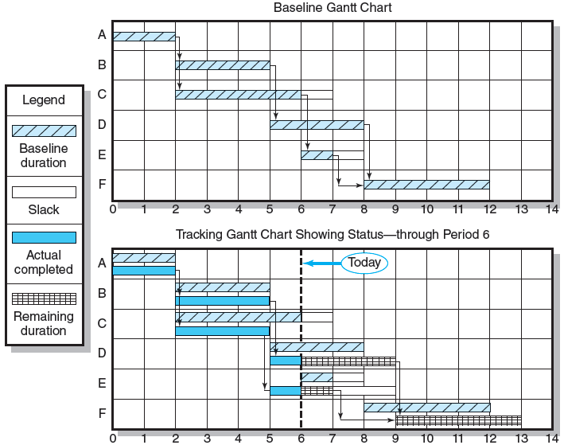
Baseline and Tracking Gantt Charts
FIGURE 13.1

Slide 9
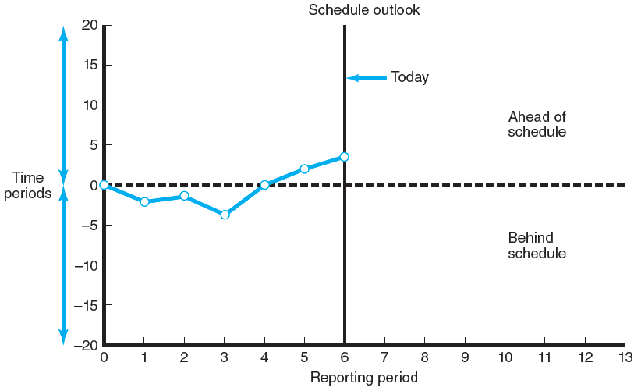
Project Schedule Control Chart
FIGURE 13.2

Slide 10
Development of an Earned Value Cost/Schedule System
Time-Phase Baseline Plan
Corrects the failure of most monitoring systems to connect a project’s actual performance to its schedule and forecast budget.
Systems that measure only cost variances do not identify resource and project cost problems associated with falling behind or progressing ahead of schedule.
Earned Value Cost/Schedule System
An integrated project management system based on the earned value concept that uses a time-phased budget baseline to compare actual and planned schedule and costs.

Slide 11
Glossary of Terms
EV | Earned value for a task is simply the percent complete times its original budget. Stated differently, EV is the percent of the original budget that has been earned by actual work completed.
PV | The planned time-phased baseline of the value of the work scheduled. An approved cost estimate of the resources scheduled in a time-phased cumulative baseline [BCWS—budgeted cost of the work scheduled].
AC | Actual cost of the work completed. The sum of the costs incurred in accomplishing work. [ACWP—actual cost of the work performed].
CV | Cost variance is the difference between the earned value and the actual costs for the work completed to date where CV = EV – AC.
SV | Schedule variance is the difference between the earned value and the baseline line to date where SV = EV – PV.
BAC | Budgeted cost at completion. Total budgeted cost of the baseline or project cost accounts.
EAC | Estimated cost at completion.
ETC | Estimated cost to complete remaining work.
VAC | Cost variance at completion. VAC indicates expected actual over- or under-run cost at completion.
TABLE 13.1

Slide 12
Developing an Integrated Cost/Schedule System
Define the work using a WBS.
Scope
Work packages
Deliverables
Organization units
Resources
Budgets
Develop work and resource schedules.
Schedule resources to activities
Time-phase work packages into a network
Develop a time-phased budget using work packages included in an activity. Accumulate budgets (PV).
At the work package level, collect the actual costs for the work performed (AC). Multiply percent complete times original budget (EV).`
Compute the schedule variance (EV-PV) and the cost variance (EV-AC).

Slide 13
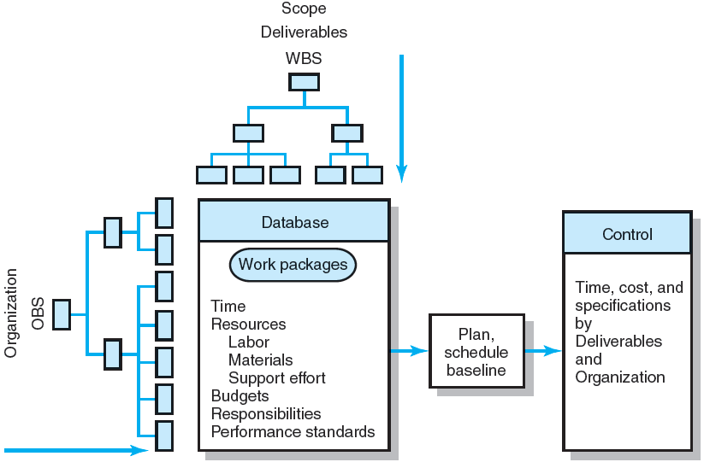
Project Management Information System Overview
FIGURE 13.3

Slide 14
Development of Project Baselines (cont’d)
Rules for Placing Costs in Baselines
Costs are placed exactly as they are expected to be “earned” in order to track them to their point of origin.
Percent Complete Rule
Costs are periodically assigned to a baseline as units of work are completed over the duration of a work package.

Slide 15
Development of Project Baselines
Purposes of a Baseline (PV)
An anchor point for measuring performance
A planned cost and expected schedule against which actual cost and schedule are measured.
A basis for cash flows and awarding progress payments.
A summation of time-phased budgets (cost accounts as summed work packages) along a project timeline.
What Costs Are Included in Baselines?
Labor, equipment, materials, project direct overhead costs (DOC)

Slide 16
Methods of Variance Analysis
Comparing Earned Value
With the expected schedule value.
With the actual costs.
Assessing Status of a Project
Required data elements
Data Budgeted cost of the work scheduled (PV)
Budgeted cost of the work completed (EV)
Actual cost of the work completed (AC)
Calculate schedule and cost variances
A positive variance indicates a desirable condition, while a negative variance suggests problems or changes that have taken place.

Slide 17
Methods of Variance Analysis
Cost Variance (CV)
Indicates if the work accomplished using labor and materials costs more or less than was planned at any point in the project.
Schedule Variance (SV)
Presents an overall assessment in dollar terms of the progress of all work packages in the project scheduled to date.

Slide 18
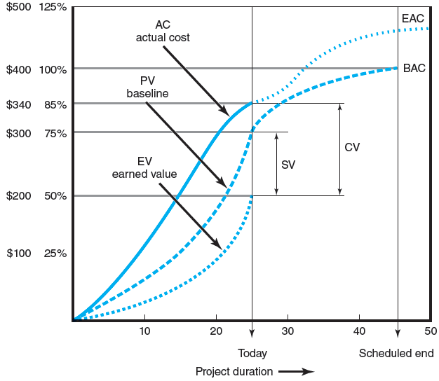
Cost/Schedule Graph
FIGURE 13.4

Slide 19
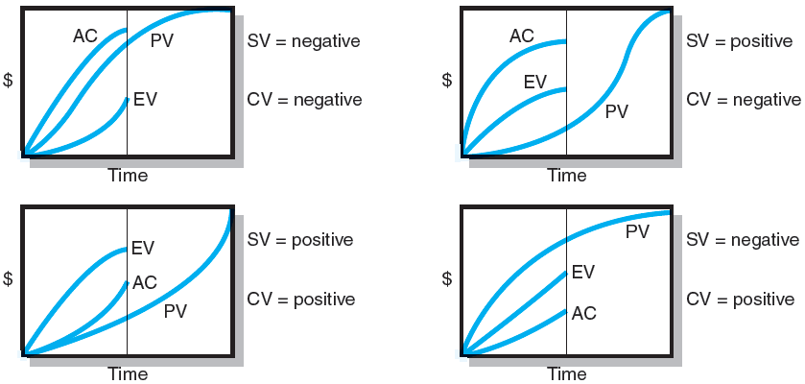
Earned-Value Review Exercise
FIGURE 13.5

Slide 20
Developing A Status Report: A Hypothetical Example
Assumptions
Each cost account has only one work package, and each cost account will be represented as an activity on the network.
The project network early start times will serve as the basis for assigning the baseline values.
From the moment work an activity begins, some actual costs will be incurred each period until the activity is completed.

Slide 21
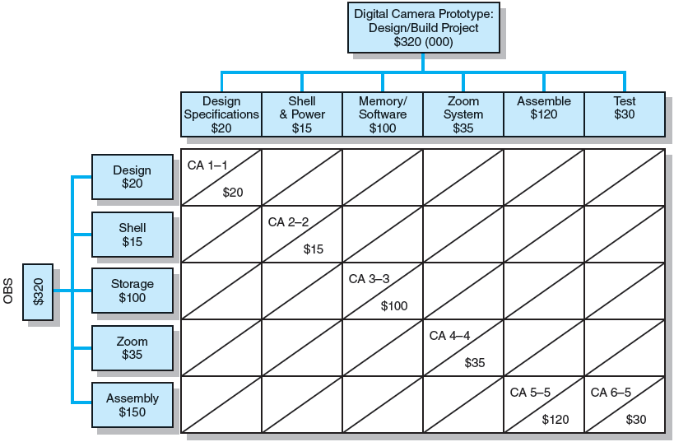
Work Breakdown Structure with Cost Accounts
FIGURE 13.6

Slide 22
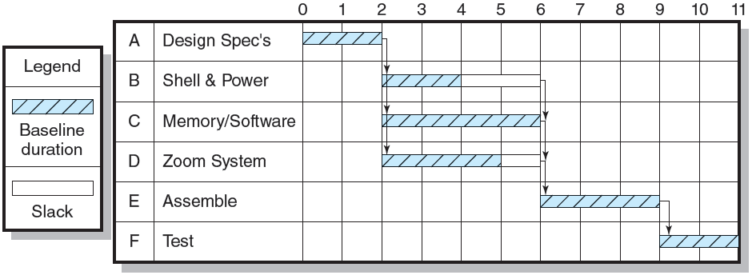
Digital Camera Prototype Project Baseline Gantt Chart
FIGURE 13.7

Slide 23
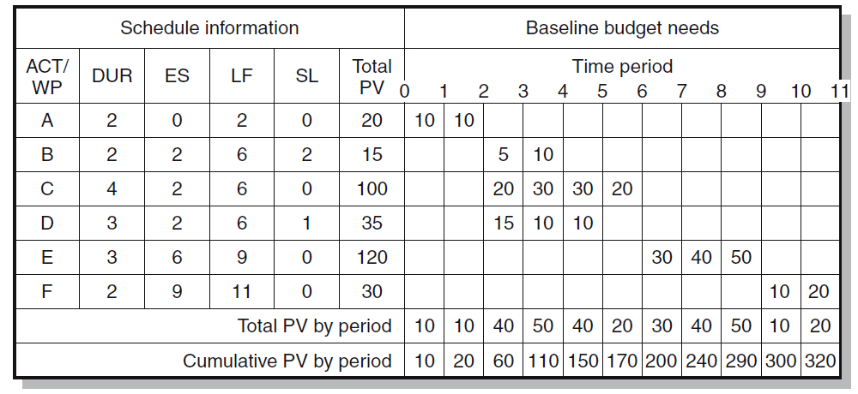
Digital Camera Prototype Project Baseline Budget ($000)
FIGURE 13.8

Slide 24
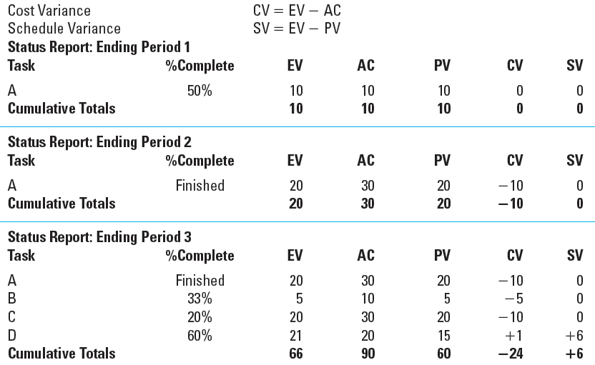
Digital Camera Prototype Status Reports: Periods 1–3
TABLE 13.2

Slide 25
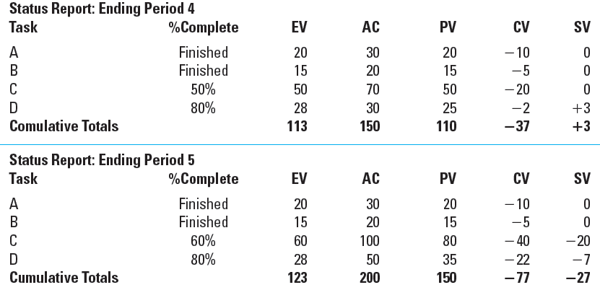
Digital Camera Prototype Status Reports: Periods 4 & 5
TABLE 13.2 (cont’d)

Slide 26
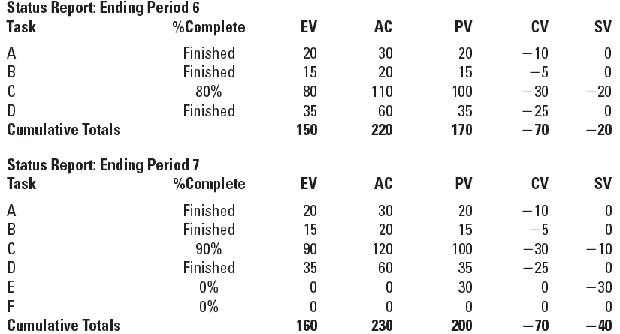
Digital Camera Prototype Status Reports: Periods 6 & 7
TABLE 13.2 (cont’d)

Slide 27
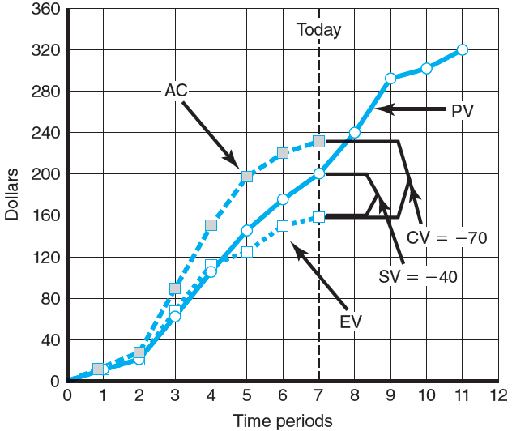
Digital Camera Prototype Summary Graph ($000)
FIGURE 13.9

Slide 28
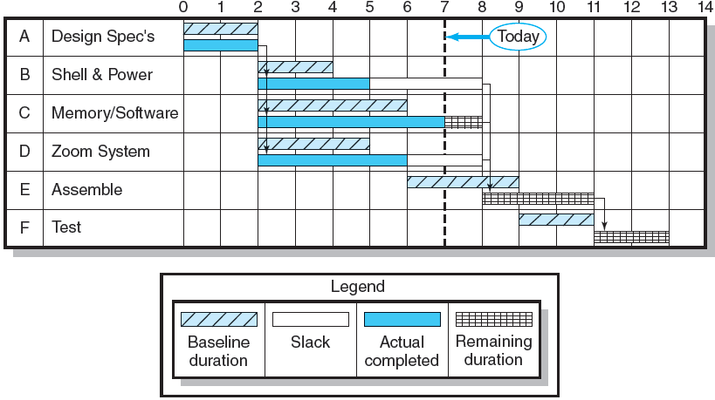
Digital Camera Project-Tracking Gantt Chart Showing Status—Through Period 7
FIGURE 13.10

Slide 29
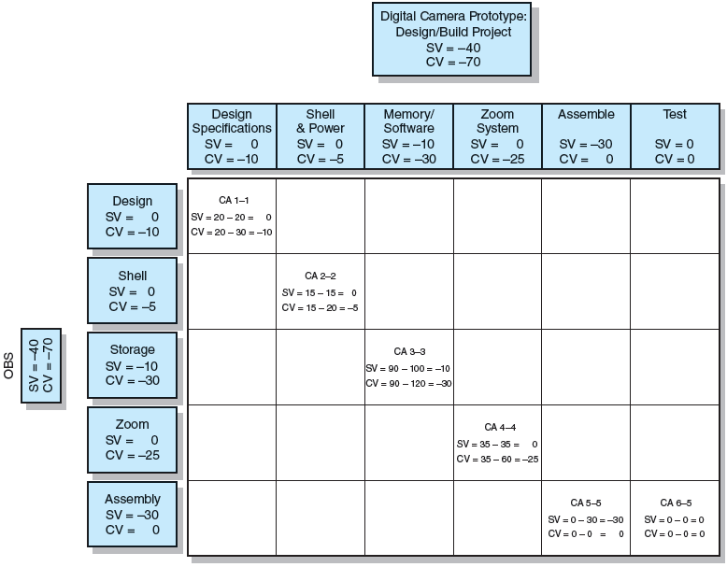
Project Rollup End Period 7 ($000)
FIGURE 13.11

Slide 30
Indexes to Monitor Progress
Performance Indexes
Cost Performance Index (CPI)
Measures the cost efficiency of work accomplished to date.
CPI = EV/AC
Scheduling Performance Index (SPI)
Measures scheduling efficiency
SPI = EV/PV
Percent Complete Indexes
Indicate how much of the work accomplished represents of the total budgeted (BAC) and actual (AC) dollars to date.
PCIB = EV/BAC
PCIC = AC/EAC

Slide 31
Interpretation of Indexes
Index | Cost (CPI) | Schedule (SPI)
>1.00 | Under cost | Ahead of schedule
=1.00 | On cost | On schedule
<1.00 | Over cost | Behind schedule
TABLE 13.3

Slide 32
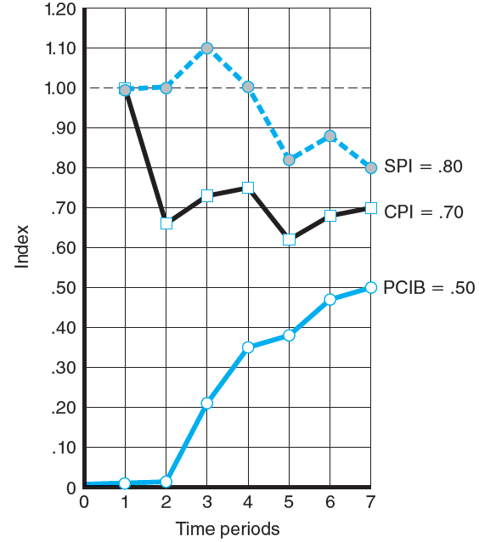
Indexes Periods 1–7
FIGURE 13.12

Slide 33
Additional Earned Value Rules
Rules applied to short-duration activities and/or small-cost activities
0/100 percent rule
Assumes 100 % of budget credit is earned at once and only when the work is completed.
50/50 rule
Allows for 50% of the value of the work package budget to be earned when it is started and 50% to be earned when the package is completed.
Percent complete with weighted monitoring gates
Uses subjective estimated percent complete in combination with hard, tangible monitoring points.

Slide 34
Forecasting Final Project Cost
Methods used to revise estimates of future project costs:
EAC_{re}
Allows experts in the field to change original baseline durations and costs because new information tells them the original estimates are not accurate.
EAC_{f}
Uses actual costs-to-date plus an efficiency index to project final costs in large projects where the original budget is unreliable.

Slide 35
Forecasting Model: EAC_{f}
The equation for this forecasting model:

Slide 36
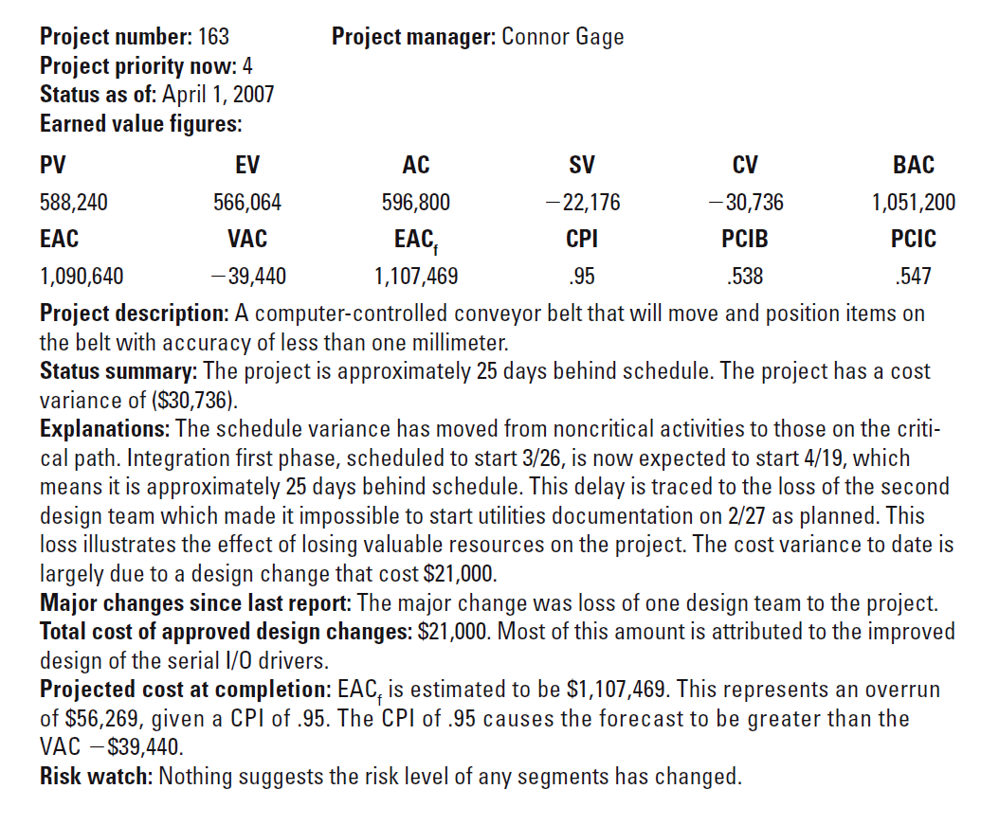
Monthly Status Report
EXHIBIT 13.1

Slide 37
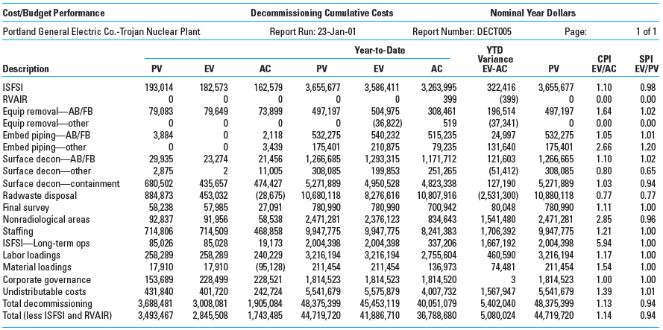
Trojan Nuclear Plant Decommissioning Earned Value Status Report
EXHIBIT 13.2

Slide 38
Other Control Issues
Issues In Maintaining Control Of Projects
Scope Creep
Baseline Changes
Data Acquisition Costs and Problems

Slide 39
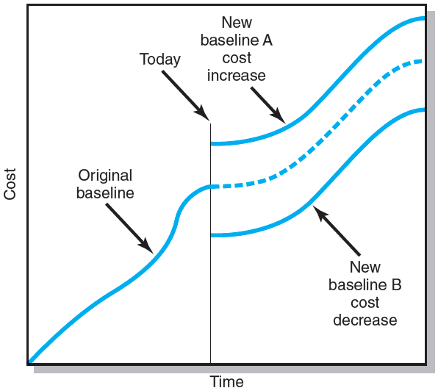
Scope Changes to a Baseline
FIGURE 13.13

Slide 40
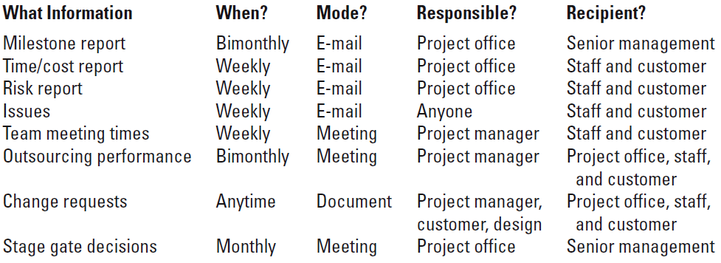
Conference Center WiFi Project Communication Plan
FIGURE 13.14

Slide 41
Key Terms
Baseline budget
Budget at completion (BAC)
Control chart
Cost performance index (CPI)
Cost variance (CV)
Earned value (EV)
Estimated Cost at Completion—Forecasted (EAC_{f})
Estimated Cost at Completion—Revised Estimates (EAC_{re})
Percent complete index—budget costs (PCIB)
Percent complete index—actual costs (PCIC)
Schedule performance index (SPI)
Schedule variance (SV)
Scope creep
To complete performance index (TCPI)
Tracking Gantt chart
Variance at completion (VAC)

